Slide 1
Black Friday Project
Shengzhe Xu, Zhiqi Chen, Qimo Li

Slide 2


Slide 3
Objectives
We want to help brands and stores:
better understand customers
find out the most popular product categories
identify and focus on the most valuable market segments
ultimately achieve higher sales, lower costs, and greater profit

Slide 4

Overview
Which demographic information affects purchase amount?
Which customers should we focus on?
Which product categories are the most popular?
What segments did we create and which one should we focus on?
What predictions were we able to make?

Slide 5
Understanding the Market

Slide 6
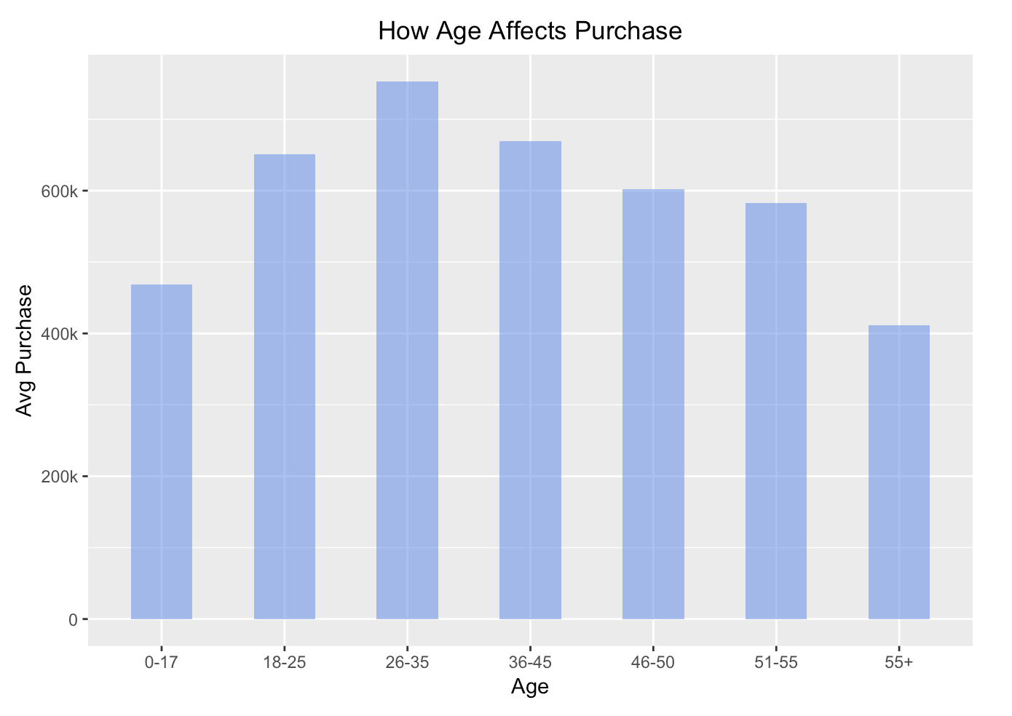
What Age Group Buys the Most?
Findings
Young adults and middle-aged people have the strongest purchasing power.
Customers from 26 to 35 years old purchase the most, buying above 750 thousand dollars on average.
We should focus on customers who are 26 to 35 years old.

Slide 7
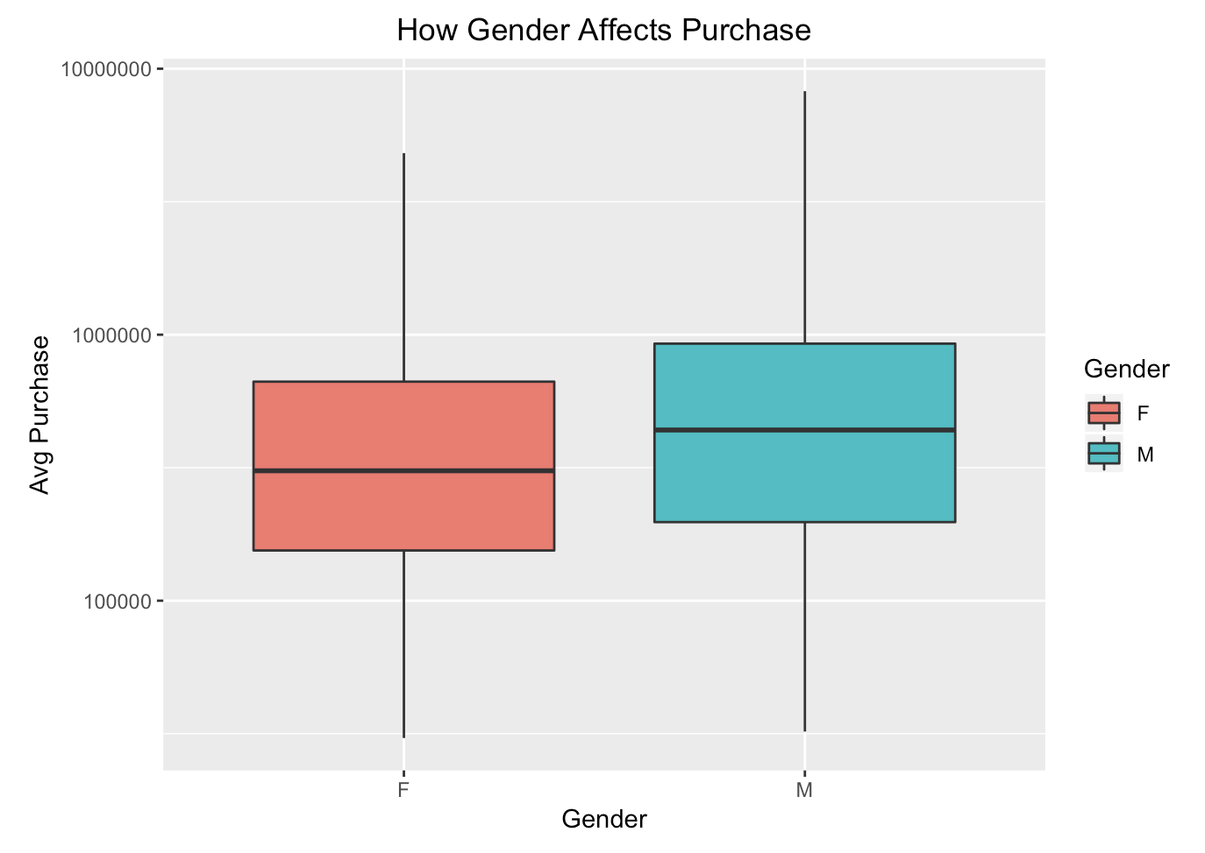
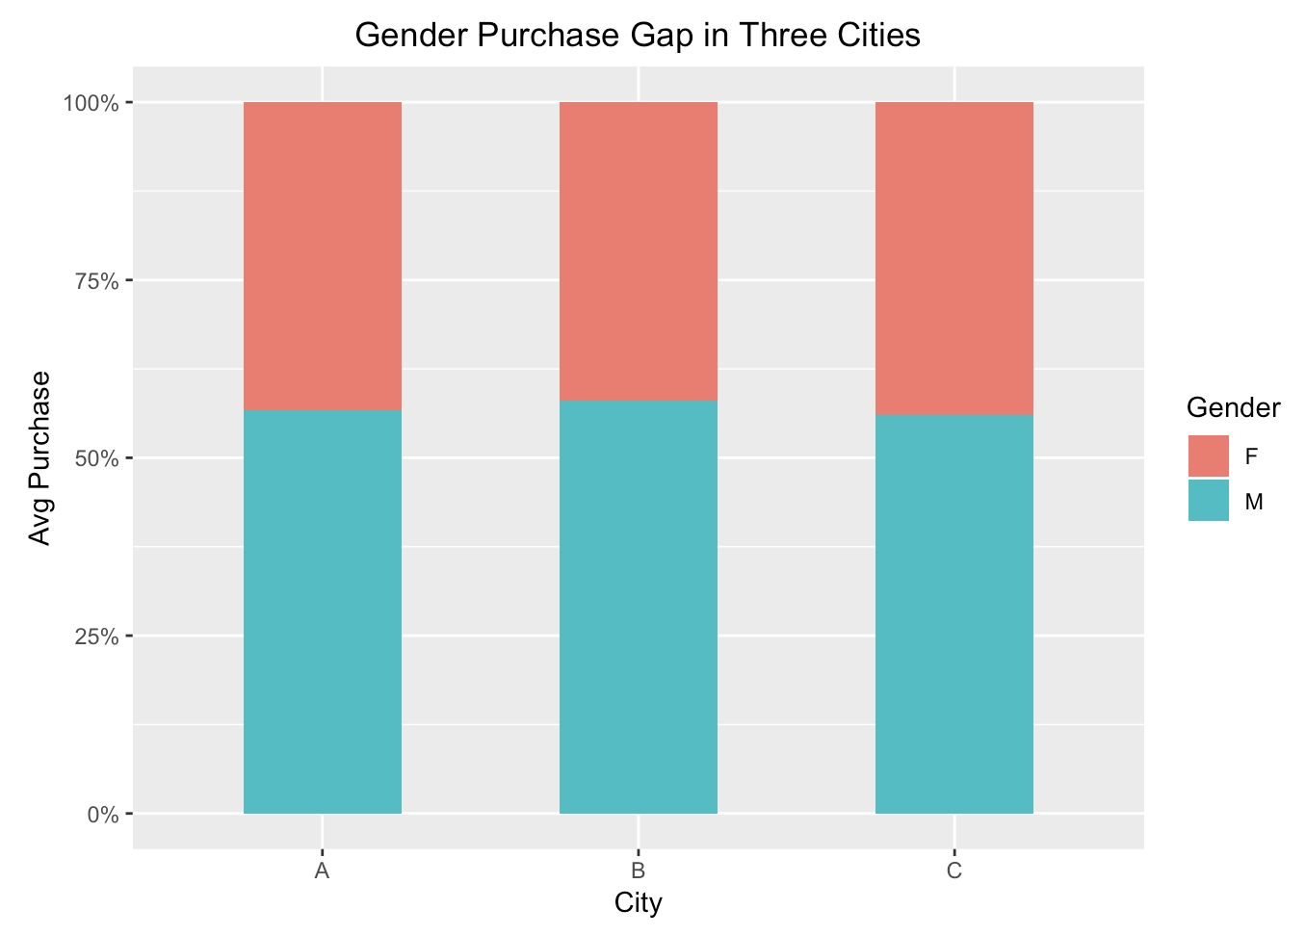
How Does Gender Influence Purchase Amounts?
Findings
On average, men purchase more than women.
In the three cities, the purchase percentages of men are all above 50%.
We should focus on males, as they has higher purchasing power than females..

Slide 8
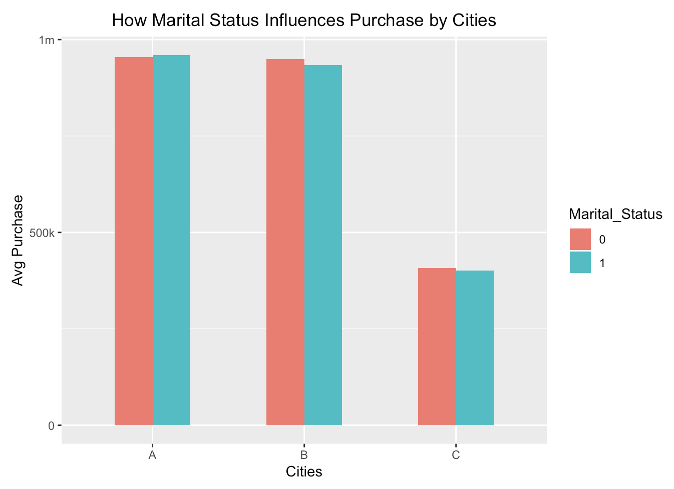
Does Marital Status Affects Purchase?
Findings
Marital status is not a key determinant of the average purchase amounts.
According to statistical analyses, there is no significant difference in the purchase amounts between married people and unmarried people.
We don’t need to consider marital status when developing market strategy.

Slide 9
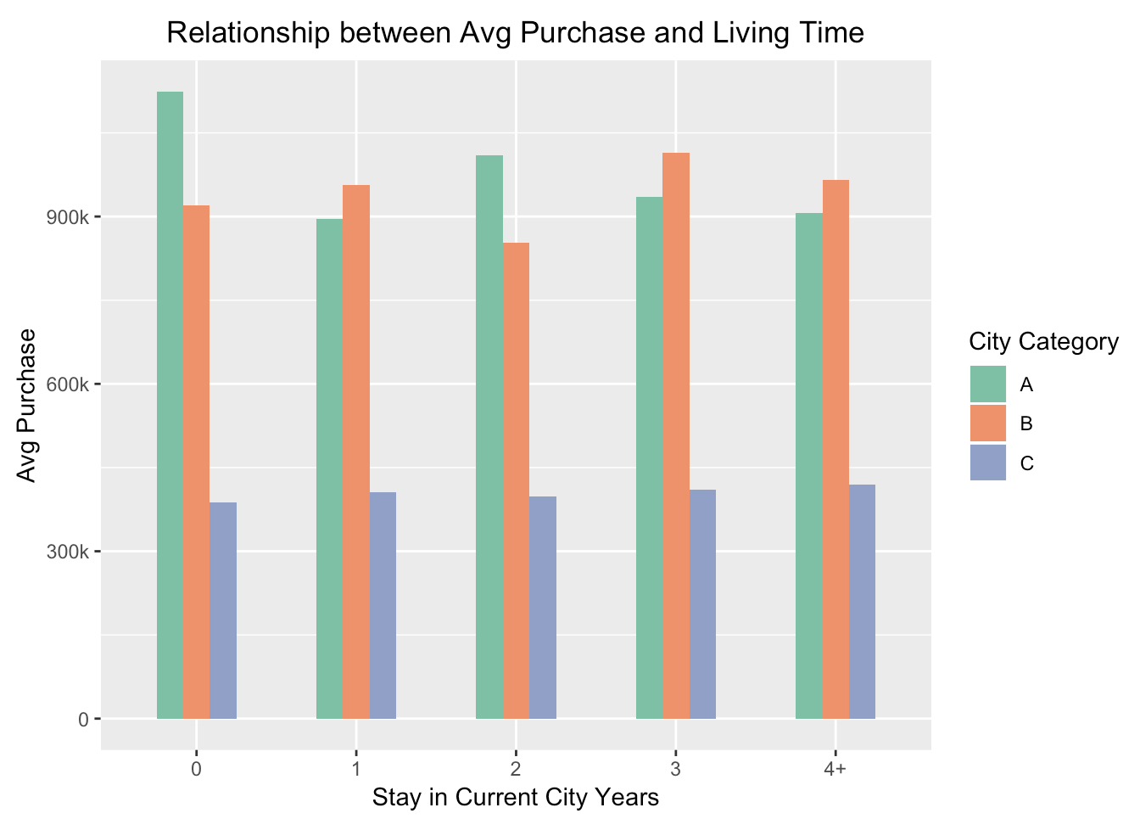
Does Staying Time Affects Purchase?
Findings
No clear pattern of the effect of staying time on purchase
People in city A and city B have stronger purchasing power than those in city C.
We should pay more attention to customers who live in city A and B.

Slide 10
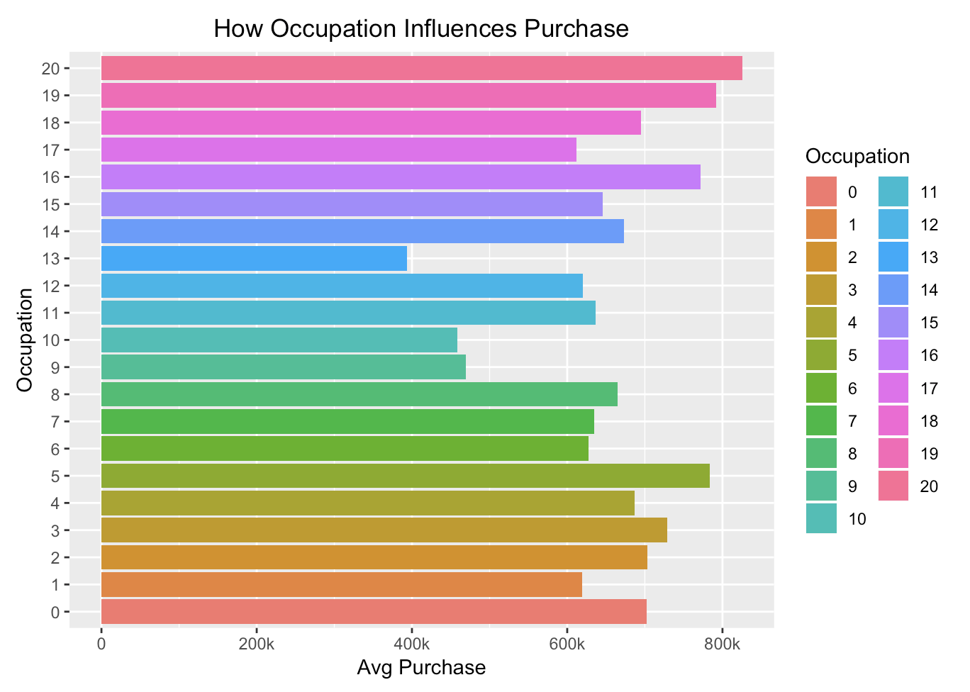
Which Occupation Buys the Most?
Findings
Occupations do affect the purchase amounts.
Occupations 5, 16, 19 and 20 spend the most, while occupations 9, 10 and 13 spend the least.
We need to focus more on Occupations 5, 16, 19 and 20.

Slide 11
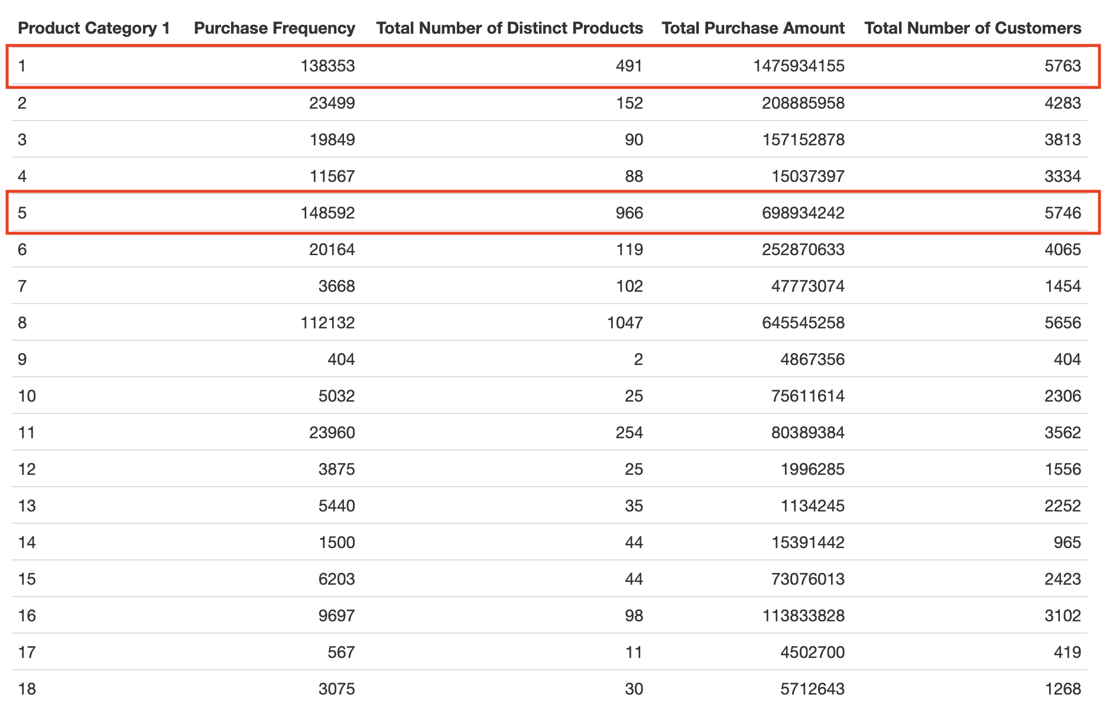
Which Product Categories Are the Most Popular?
Findings
We should focus on category 1 and 5, as these categories have the highest total purchase amounts.

Slide 12
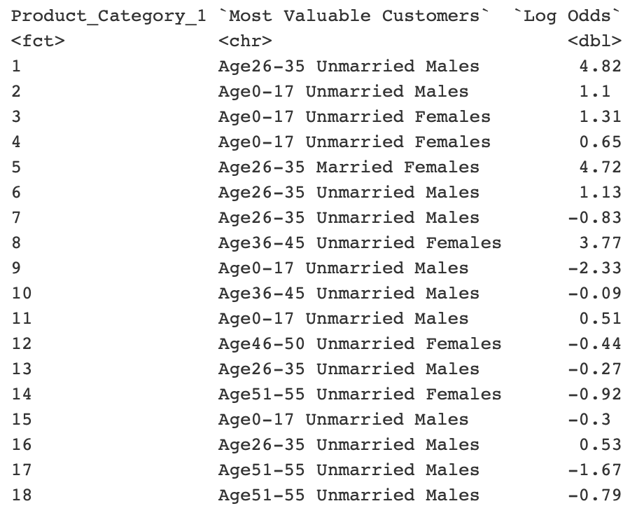

Most Valuable Customers for Each Product Category 1
22

Slide 13
Segmentation and Model Selection

Slide 14
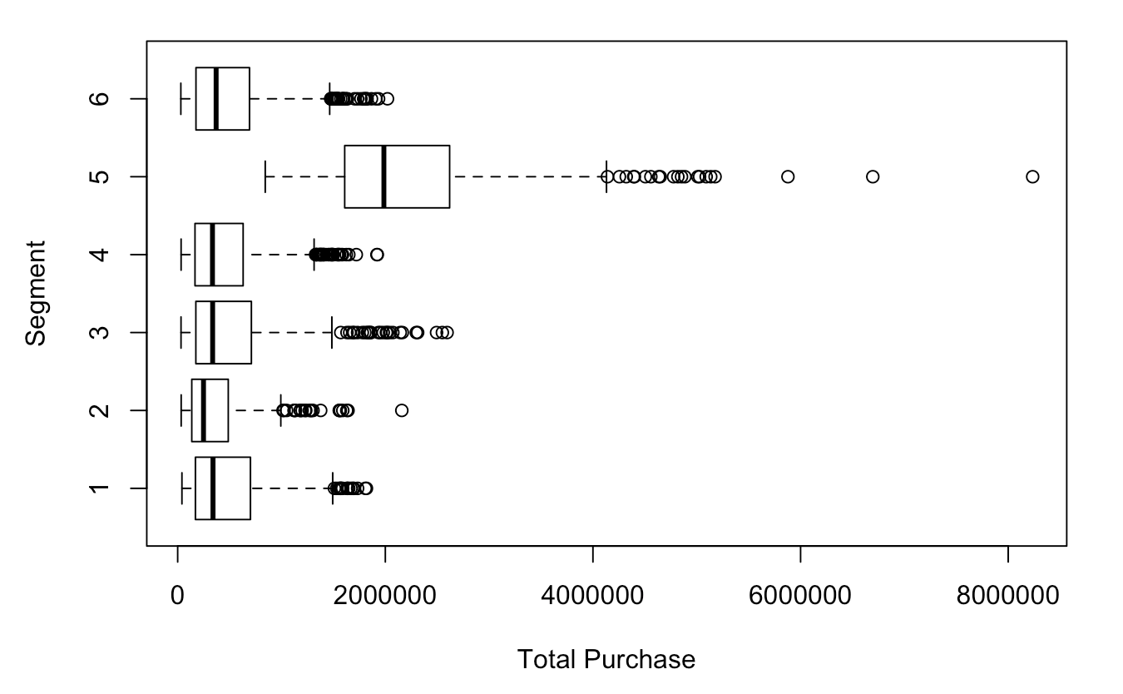
Segmentation
Characteristics
Group 5 has the highest average purchase amount.
81% of the people in group 5 are males, and 57% of them are 26-35 years old.
30% are from city A and 70% are from city B.
On average, they bought 323 items and spent 2.2 million dollars.

Slide 15

Predictive Model Selection

Slide 16
The Best Predictive Model
The one that has everything in.

Slide 17
Predictive Analyses

Slide 18
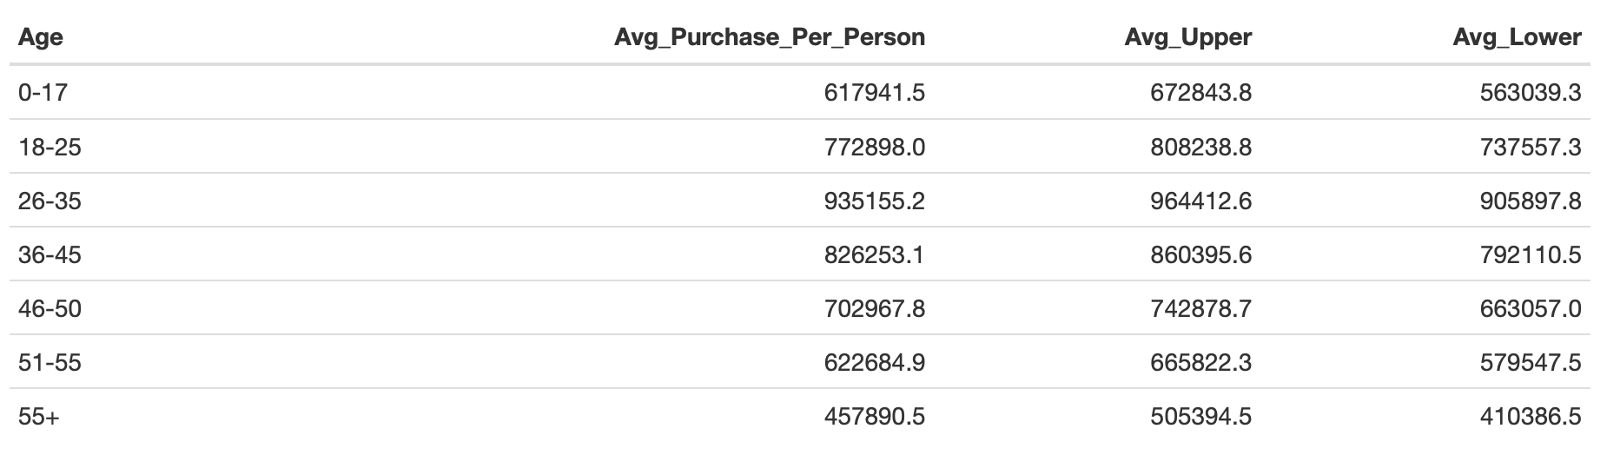
Predictive Analyses

Slide 19
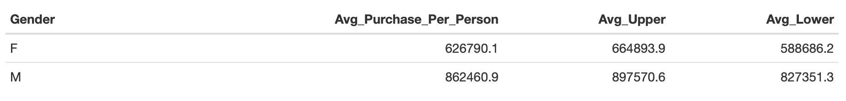
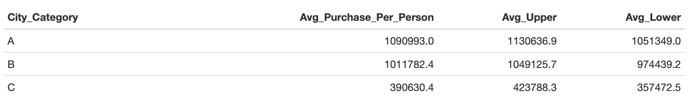
Predictive Analyses

Slide 20
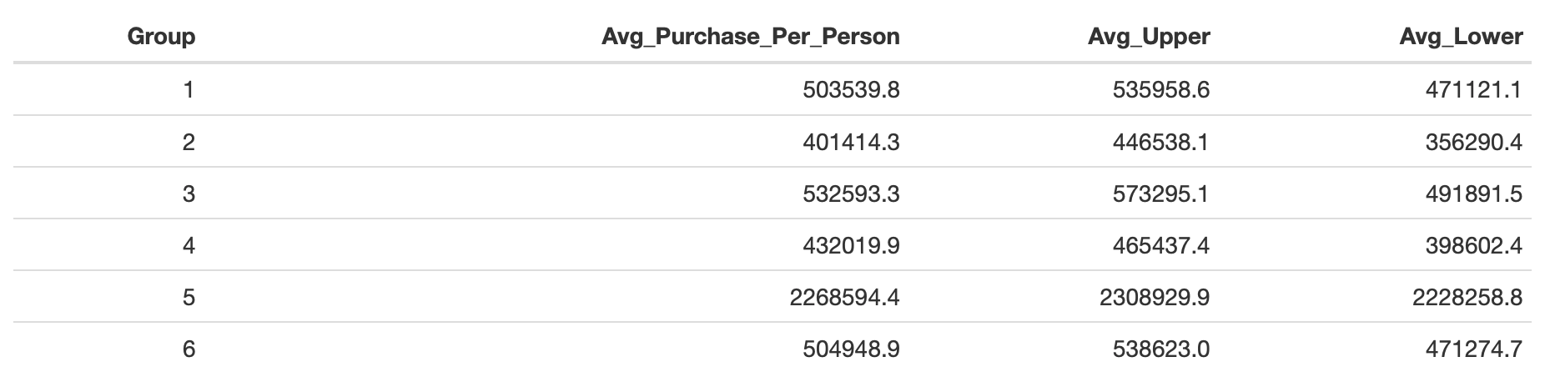
Predictive Analyses

Slide 21
Summary and Conclusion

Slide 22
Conclusion
Primary Analysis
Model Selection
Recommendations
Data Cleaning
Visualizations
Statistical Analyses
Regression Analyses
Segmentation
Predictive Analyses
Age
Gender
City
Occupation
Product Category
Predications

Slide 23
Conclusion
Age
26 - 35 years old
Gender
Male
City
City A
City B
Category 1
Category 5
Product Category

Slide 24
Thank You for Your Attention!

